Slide 1
Why Stuff Happens
The Crux of the Dance
Thermodynamics
“A law is more impressive the greater the simplicity of its premises, the more different are the kinds of things it relates, and the more extended its range of applicability. It is the only physical theory of universal content, which I am convince, that within the framework of applicability of its basic concepts will never be overthrown.” (Einstein)

Slide 2
Quick Check - Entropy
(a) CaCO3 (s) → CaO (s) + CO2 (g) ……………..
(b) N2 (g) + 3H2 (g) → 2NH3 (g) ………………..
(c) CH3COO⁻Na⁺ (aq) → CH3COO⁻Na⁺ (s) …..
(d) NaCl (s) → NaCl (aq) …………………………
(e) 2H2O (l) → 2H2 (g) + O2 (g) …………….……
Products
Reactants
Reactants
Products
Products

Slide 3
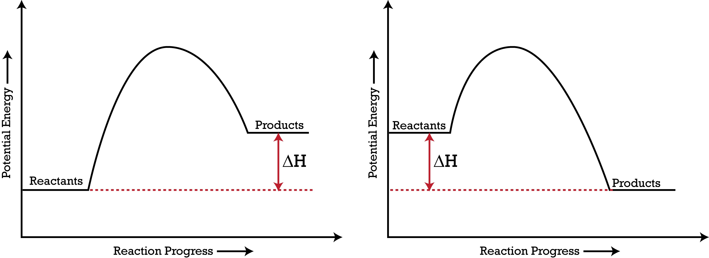
The Problem
We usually expect a system to go from a less to a more stable state.
Increased stability implies a lower energy state.
Which is the better choice, exothermic or endothermic, when considering if a reaction will take place or not?
Exothermic
Energy
Energy

Slide 4
Experiments/Demonstrations
(a) The Imploding Bottle (NaOH and CO2)
Question | Observation/Answer
Upon addition of the tablets, a whole lot of CO2 (g) was produced. At this point, is the entropy of the system high or low? | Entropy of system is high.
What changed upon adding NaOH (aq)? What can you say about the entropy change of the system? | The bottle collapsed. The gas had reacted with the NaOH (aq). There is a decrease in entropy.
Was the bottle warm to the touch? What does this us about the enthalpy change of the reaction or system? | Bottle is a little warm. Enthalpy change of reaction is negative, i.e. exothermic.
Write the chemical reaction for this reaction. State if the entropy increased or decreased on going from reactants to products. | CO2 (g) + NaOH (aq) → NaHCO3 (aq) Entropy decreased.

Slide 5
Experiments/Demonstrations
Solid and Solid (Ba(OH)2 and NH4Cl)
Question | Observation/Answer
How did the consistency change upon mixing the two solid together? How is the entropy changing? | Entropy is increasing.
Was there any gas evolved? What was it? | Pungent gas evolved. Gas is most likely ammonia. Entropy of system is increasing significantly.
What special “heavy lifting” could the beaker do? Why could it do this? What was the enthalpy change? | The beaker could lift the mat. The thin film of water had frozen: the beaker was now “stuck” to the mat. The reaction is endothermic.
Write the chemical reaction for this reaction. State if the entropy increased or decreased on going from reactants to products. | Ba(OH)2 (s) + 2NH4Cl (s) → BaCl2 (aq) + 2H2O (l) + 2NH3 (g) Entropy increased (substantially).

Slide 6
Experiments/Demonstrations
So what’s “strange” here?
Solid reacted with another solid
Endothermic reaction occurred very readily

Slide 7
The Second Law of Thermodynamics
The entropy of the universe always increases in the course of a spontaneous reaction: dSuniverse > 0 (where dSuniverse = dSsystem + dSsurroundings)

Slide 8
The Second Law of Thermodynamics
What is entropy?
Extremely involved concept
Originally conceived when thinking about how energy was not used effectively (i.e. non-useful work)
Rudolf Clausius first coined the term entropy (trope in Greek means transformation)
Boltzmann gave the best (statistical) view of entropy: S=kBlnΩ

Slide 9
The Second Law of Thermodynamics
What is entropy? Entropy is defined as the extent or degree of disorder in a system. The higher the disorder or the more random the system is (i.e. more permutations to configure its constituent particles) the higher the entropy.

Slide 10
The Second Law of Thermodynamics
What is entropy?
lower entropy
higher entropy
Supply thermal energy or heat the system

Slide 11
The Second Law of Thermodynamics
The more heat or thermal energy supplied, the higher the entropy. It seems like the change in entropy is directly proportional to the heat supplied.

Slide 12
The Second Law of Thermodynamics

Slide 13
Play With The Equation and Give It Meaning

Slide 14

What Does It Mean?
dG = dH -TdS
dH = dG + TdS
dH

Slide 15
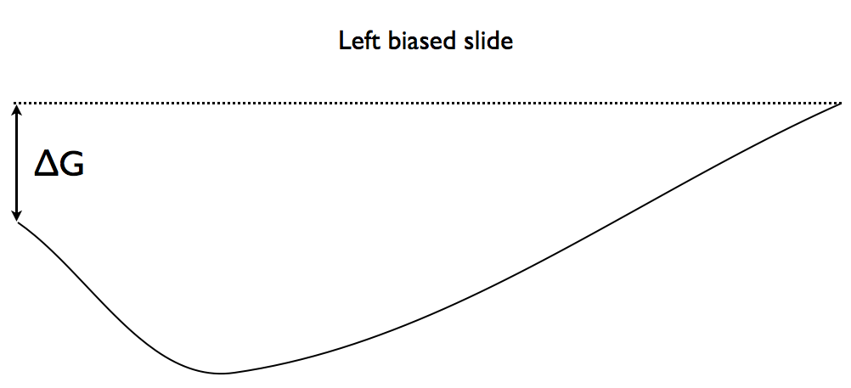
Varying Extents of dG
products
reactants
There are reactants and products at the end of the reaction. However, there is a greater proportion of reactants than products because dG is slightly positive.
70% reactants, 30% products
Arrow used to represent chemical reaction: ⇄

Slide 16
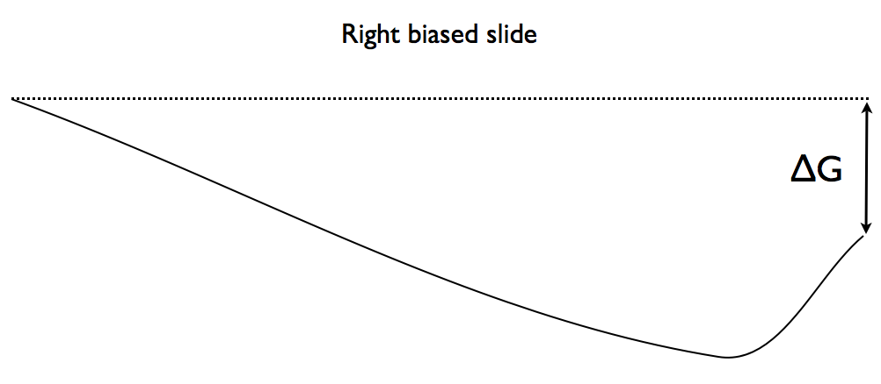
Varying Extents of dG
reactants
products
There are reactants and products at the end of the reaction. However, there is a greater proportion of products than reactants because dG is slightly negative.
30% reactants, 70% products
Arrow used to represent chemical reaction: ⇄

Slide 17
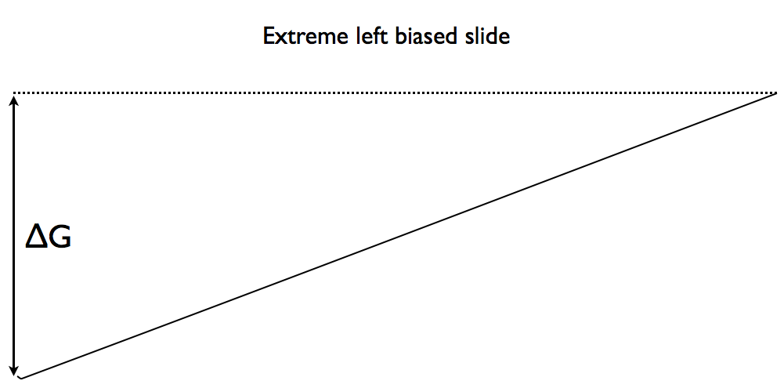
Varying Extents of dG
products
reactants
There are reactants and products at the end of the reaction. However, there is almost only reactants and nearly no products because dG is very positive (i.e. dG >> 0)
99% reactants, 1% products
Arrow used to represent chemical reaction: → i.e. no reaction

Slide 18
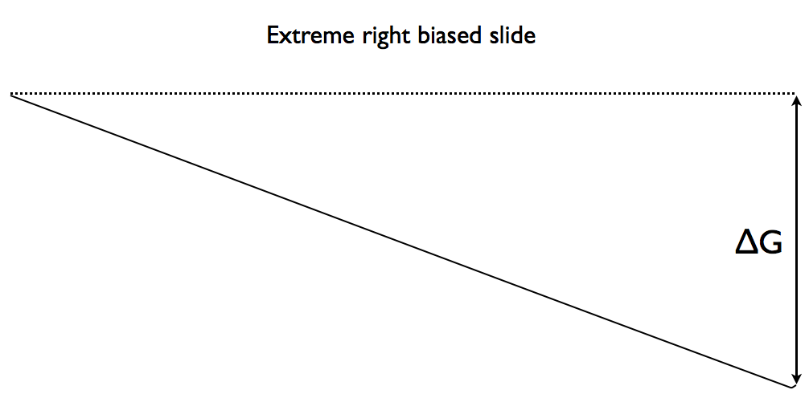
Varying Extents of dG
reactants
products
There are reactants and products at the end of the reaction. However, there is almost only products and nearly no reactants because dG is very negative (i.e. dG << 0)
1% reactants, 99% products
Arrow used to represent chemical reaction: →

